Slide 1



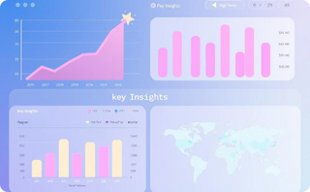




By: Suchorita Das
Data Analyst Aspirant | SQL, Excel, & Business Insights | Udemy Dataset Case Study
This presentation provides a data-driven analysis of course performance.
Based on a comprehensive dataset from Udemy.
We explore key aspects of Udemy course performance.
Uncovering key insights and strategic opportunities.
Notes:
1

Slide 2


Content:
Case Study Context
Dataset Snapshot
Database Design Overview
Subject wise Total Revenue
Course level wise Revenue generate
Top 10 courses causing Maximum Revenue Loss
Engagement based on Duration
Free vs Paid more Engaging Content
Under-priced High demand Courses
Yearly Growth Trends
Key Findings
Recommended Actions
Thank You
Notes:
2

Slide 3
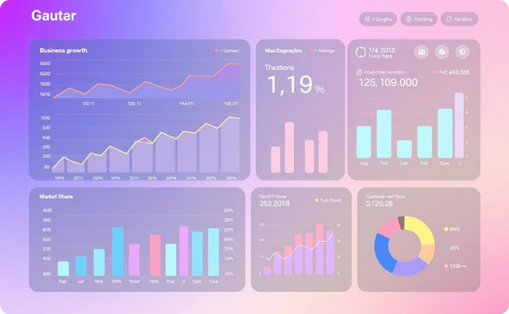


📚About Udemy – Case Study Context
Strategic Analysis
Udemy's Global Reach
Uncovering Key Insights
Our analysis of Udemy course data focuses on identifying opportunities for revenue growth, price optimization, and enhanced engagement.
Udemy is a leading online learning platform, serving over 60 million learners with 200,000+ courses across diverse subjects worldwide.
This study investigates the drivers of course success, the impact of pricing on performance, and the subjects and formats that attract the most learners.
Leveraging SQL and Excel, PowerPoint I transformed raw course data into clear, actionable insights, empowering instructors and platforms to make more informed decisions.
Notes:
3

Slide 4


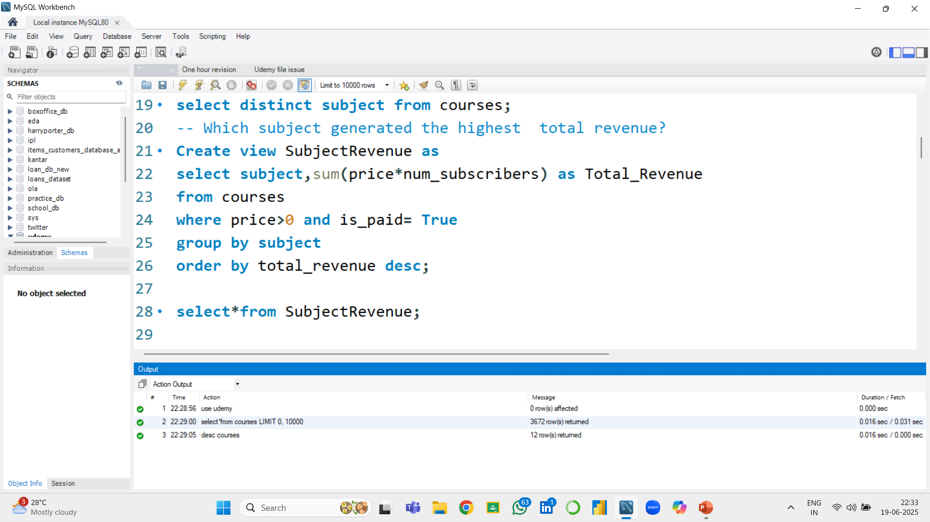
Total Revenue by Subject
Dataset Snapshot
Source: Kaggle – Udemy Dataset, comprising over 3,600 course records.
Key Fields Analyzed:
Course Information: Course ID, Title, URL
Pricing & Engagement: Is Paid, Price, Number of Subscribers, Number of Reviews
Content Details: Number of Lectures, Level, Content Duration
Publishing & Subject: Published Timestamp, Subject
Dataset Overview:
Total Courses: 3,672 analyzed
Course Subjects: 4 major categories – Web Development, Business/Finance,
Graphic Design, Musical Instruments
Course Types: Free and Paid
Levels: Beginner, Intermediate, Expert, All-Level
Time Range: Courses published between 2011 and 2017
Insight:
Web Development courses generated the highest revenue at 6.27 Cr, nearly triple that of Business Finance. This suggest strong alignment between learner demand and monetization in tech-focused content.

Slide 5


Tools and Workflow:
1. MySQL Workbench (Structured Query Language)
• Primary tool for data querying, filtering, and joining tables.
• Used to generate insights from raw datasets (e.g., user behaviour, course ratings, revenue trends).
2. Microsoft Excel
• Used to import query results and create interactive charts and visualizations.
• Enabled clean formatting and chart design for reporting.
3. PowerPoint
• Final presentation medium for compiling insights, charts, and conclusions.
• Made the project visually engaging and easy to communicate.
4. Command Prompt (CMD)
• Used to efficiently import large datasets using command-line utilities.
• Enabled faster data handling compared to manual import.

Slide 6

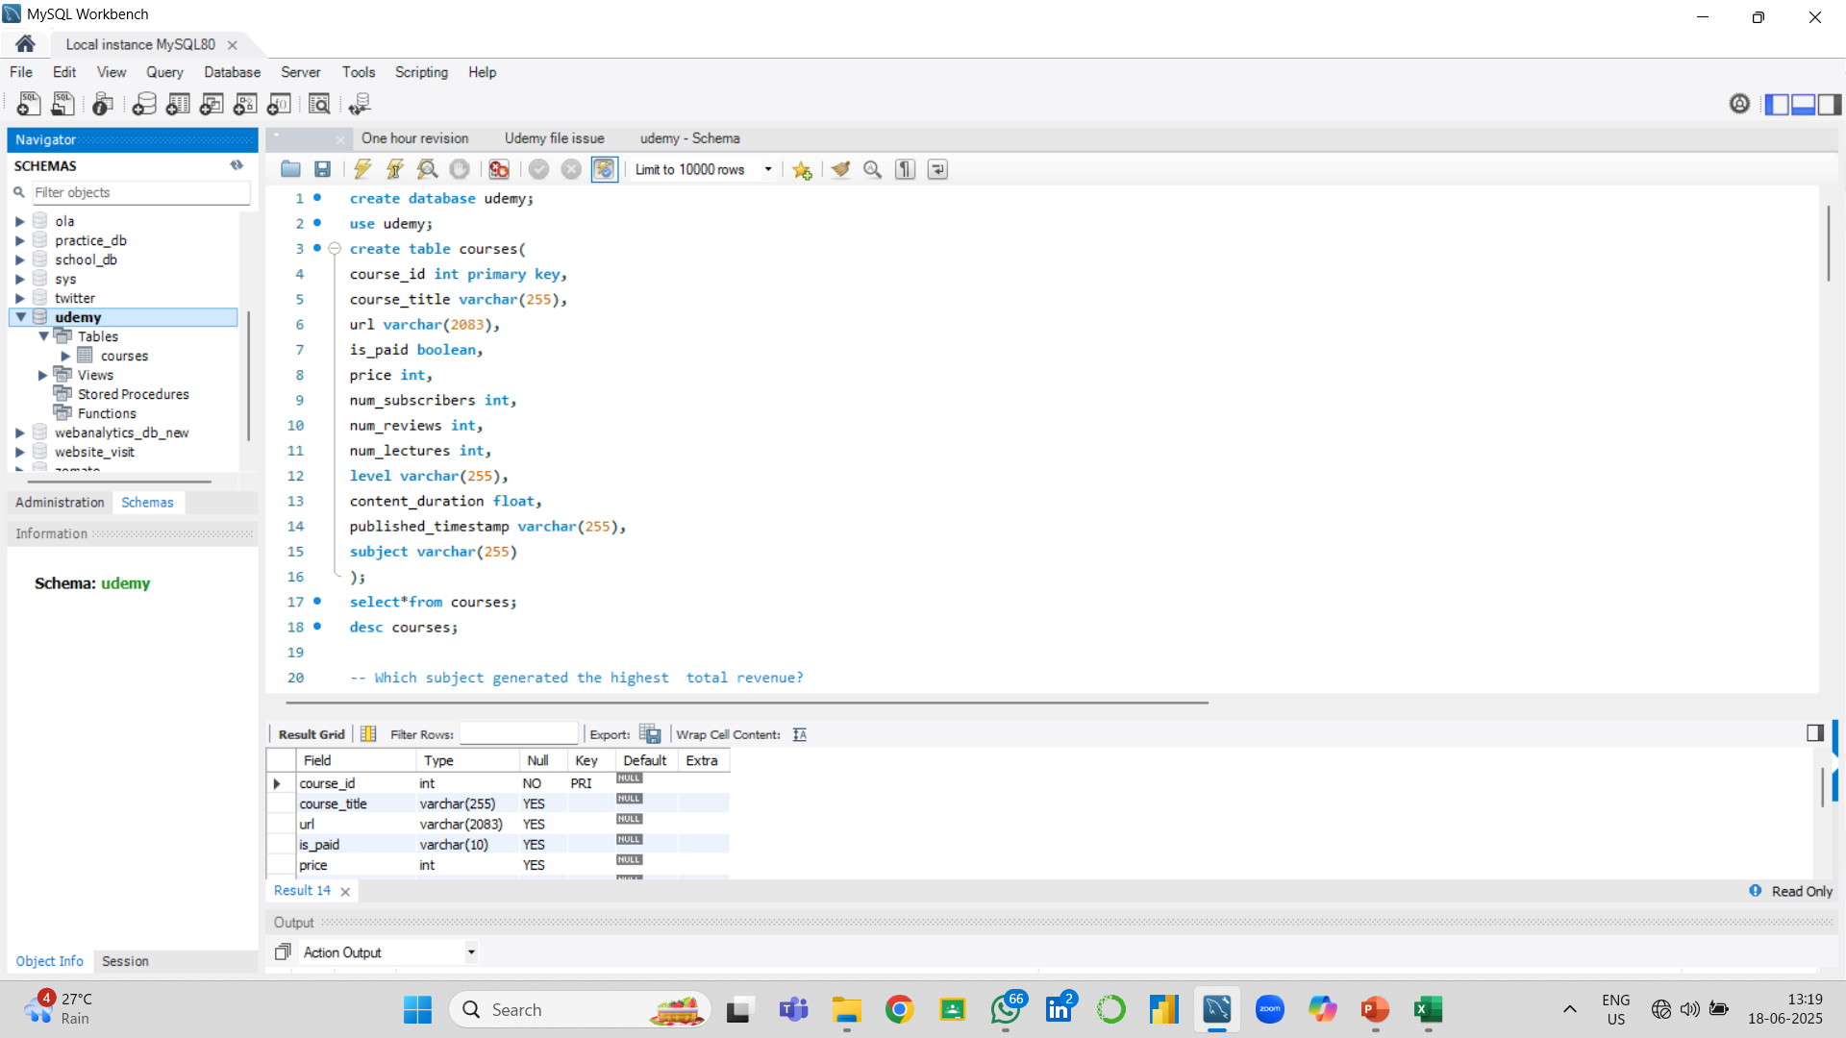
📄 Database Design Overview
Database Design Overview
create database Udemy;
use Udemy;
Table Name: courses • Primary Key: course_id
create table courses
(course id int primary key,
Course title varchar(255),
URL varchar(2083),
is_paid varchar(10),
price int,
Num subscribers int,
Num reviews int,
Num lectures int,
level varchar(255),
content duration float,
published timestamp varchar(255), subject varchar(255));

Slide 7


Analytical Focus Area:
💰 Revenue-based Analysis
Subject-wise Total Revenue
➤ Identify which subject categories generate the most revenue
Course-Level wise Revenue Generation
➤ Pinpoint high-earning individual courses
Top 10 Free Courses Causing Revenue Loss
➤ Detect free content that could be monetized
📊 Engagement Metrics Analysis
Engagement vs Course Duration
➤ Analyse whether course length affects learner engagement
Free vs Paid Course Engagement
➤ Compare how users interact with free vs paid content
🏷 Pricing Optimization
Identify Underpriced, High-Demand Courses
➤ Spot courses with high traffic but low pricing for strategic repricing
📈 Trend Analysis Year-wise
Revenue & Engagement Trends
➤ Identify growth patterns or seasonal spikes
➤ Predict future performance using past trends

Slide 8

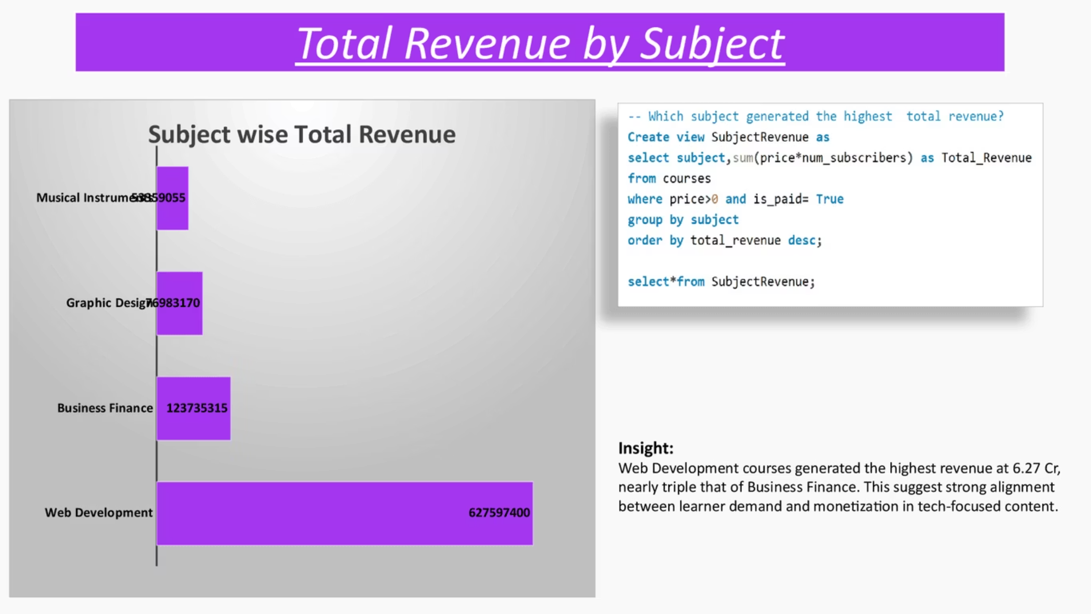
Subject wise Total Revenue
Insight:
Web Development courses generated the highest revenue at 6.27 Cr, nearly triple that of Business Finance. This suggest strong alignment between learner demand and monetization in tech-focused content.

Slide 9

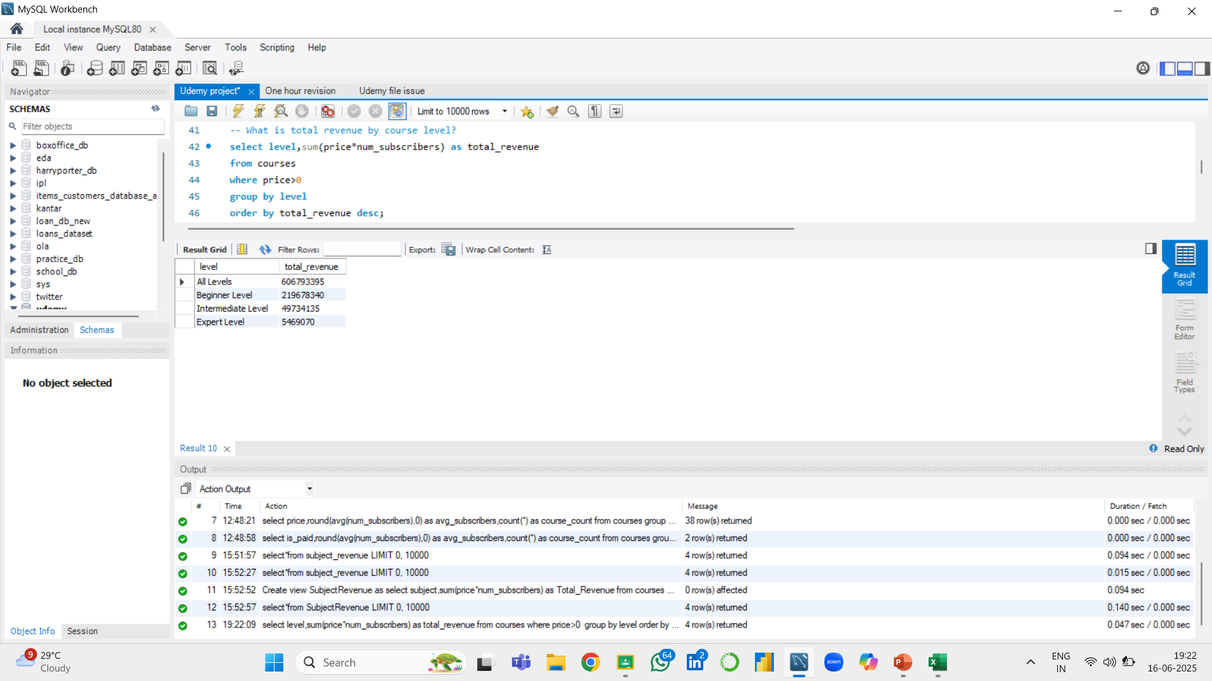

Course level wise Revenue generate
Insight:
All levels courses generated the highest revenue (606793395), indicating strong learner interest in flexible content that spans across skill stages. Beginner level courses followed distantly(219678340),while Intermediate and Expert levels contributed minimally.
This suggests a shift in learner behaviour toward broader ,inclusive learning paths, and highlights a performance gap in specialized course subjects.
Notes:
7

Slide 10

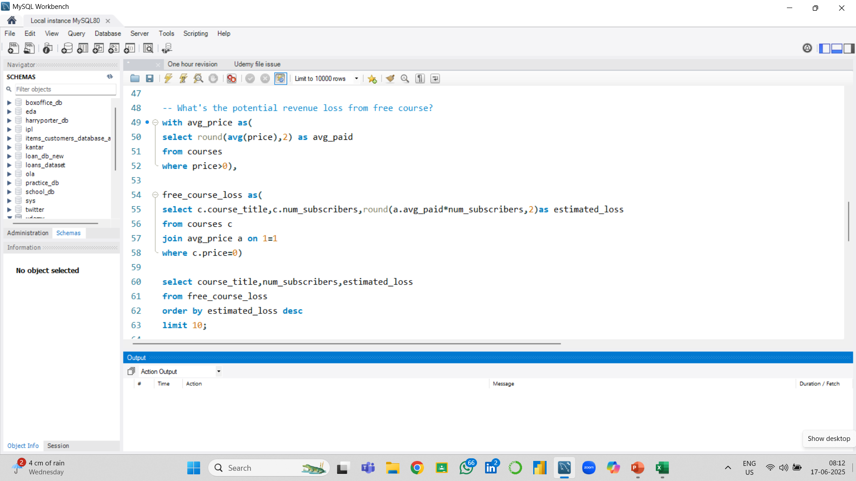
Top 10 Free courses causing Maximum Revenue Loss
Insight:
Among the free courses on Udemy , a small number are responsible for a disproportionately high potential revenue loss.
Over here the course “Learn HTML5 Programming from scratch” is the top contributor to revenue loss (24%).
The drop-off after the first few courses is steep , suggesting a Pareto distribution
Most top-loss courses are centered around Web Development , Bitcoin and Website launch , suggesting this categories might be overly saturated with free content.
Notes:
8

Slide 11

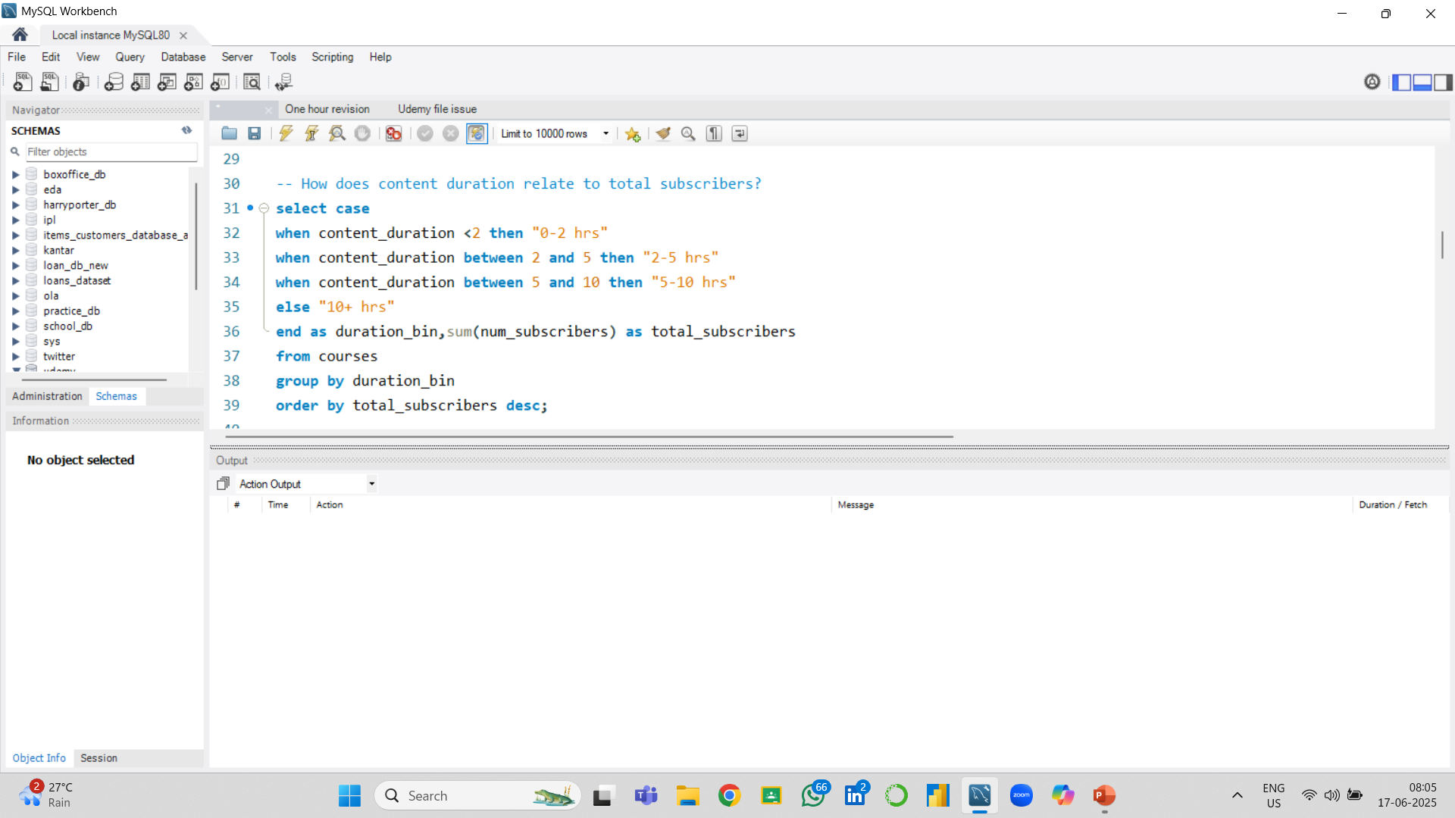
Engagement based on Course Duration
Insight:
To maximize user engagement on Udemy, focus on designing courses around 2-5 hr range.
This duration hits the optimal balance between user interest, perceived value and time efficiency
Notes:
9

Slide 12

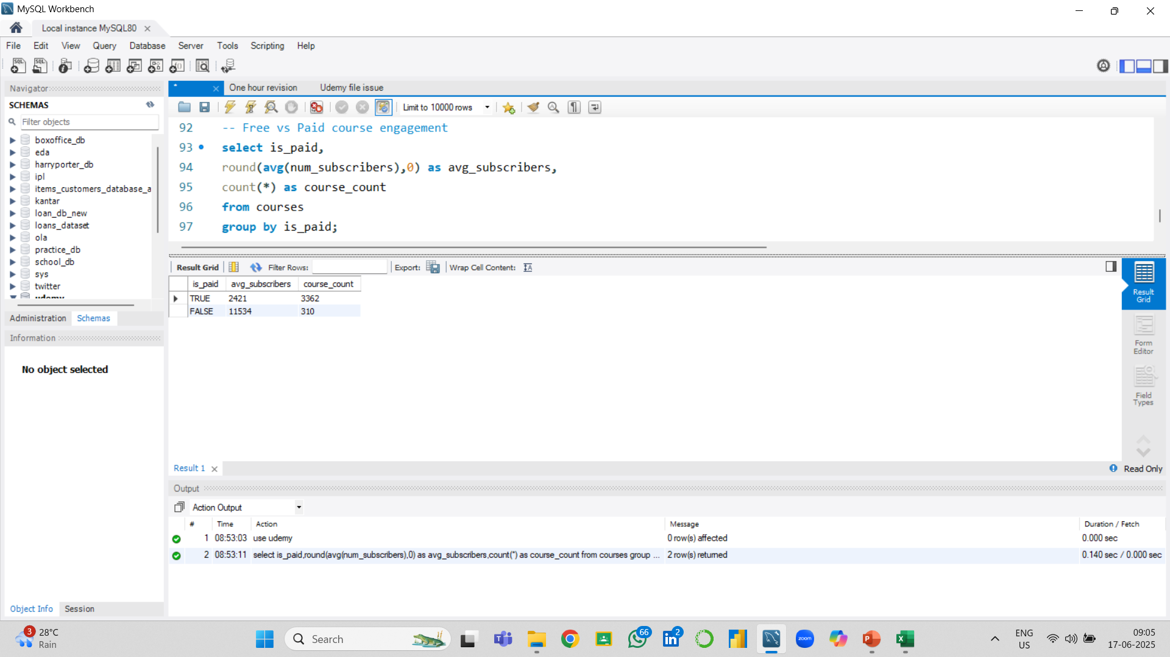
Free Vs Paid more engaging contents
Insight:
Free Courses Have Higher Engagement Despite being free, these courses have 4.7x more average subscribers than paid ones. This indicates that users are more willing to enroll in free content, making them an excellent gateway for user acquisition.
Paid Courses Are More Numerous With 3,862 paid courses vs. 310 free ones, the platform is clearly prioritizing monetized content. However, the low engagement for paid courses suggests a potential value or pricing gap.
Notes:
10

Slide 13

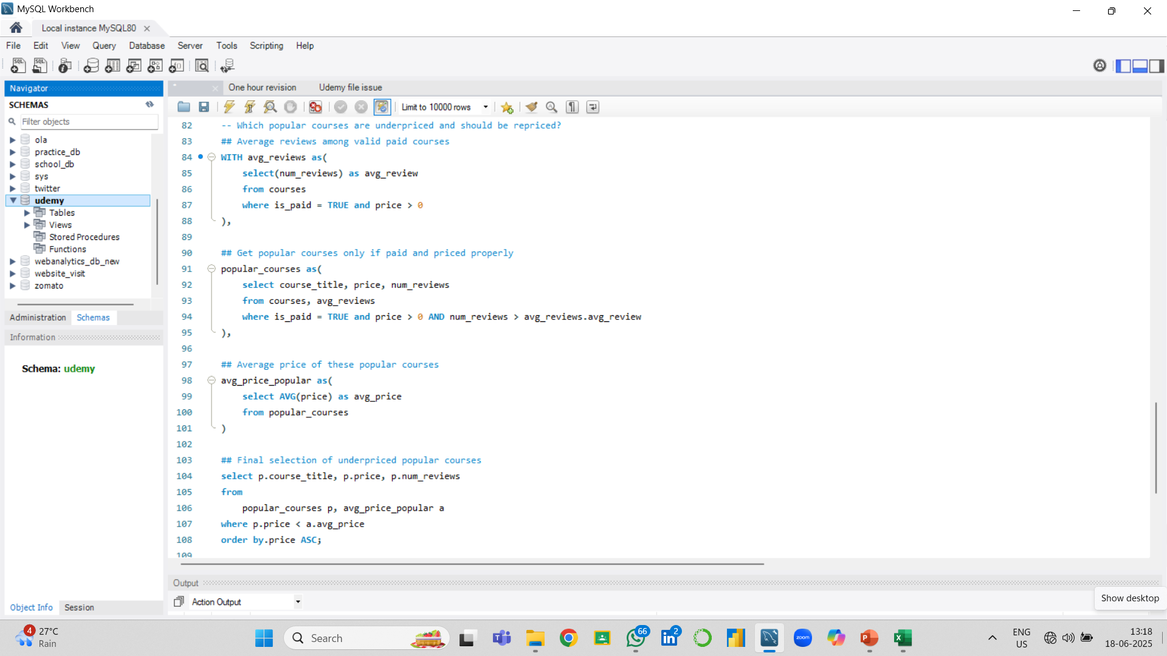
Identifying Underpriced High-demand Courses for Repricing Strategy
Insight:
The chart identifies courses with a high number of user reviews- a key indicator of popularity –yet priced significantly lower than expected. These include highly rated courses in development, design and tech categories. The pricing does not align with their demand, indicating strong potential for undervaluation and missed revenue opportunities.
Notes:
11

Slide 14

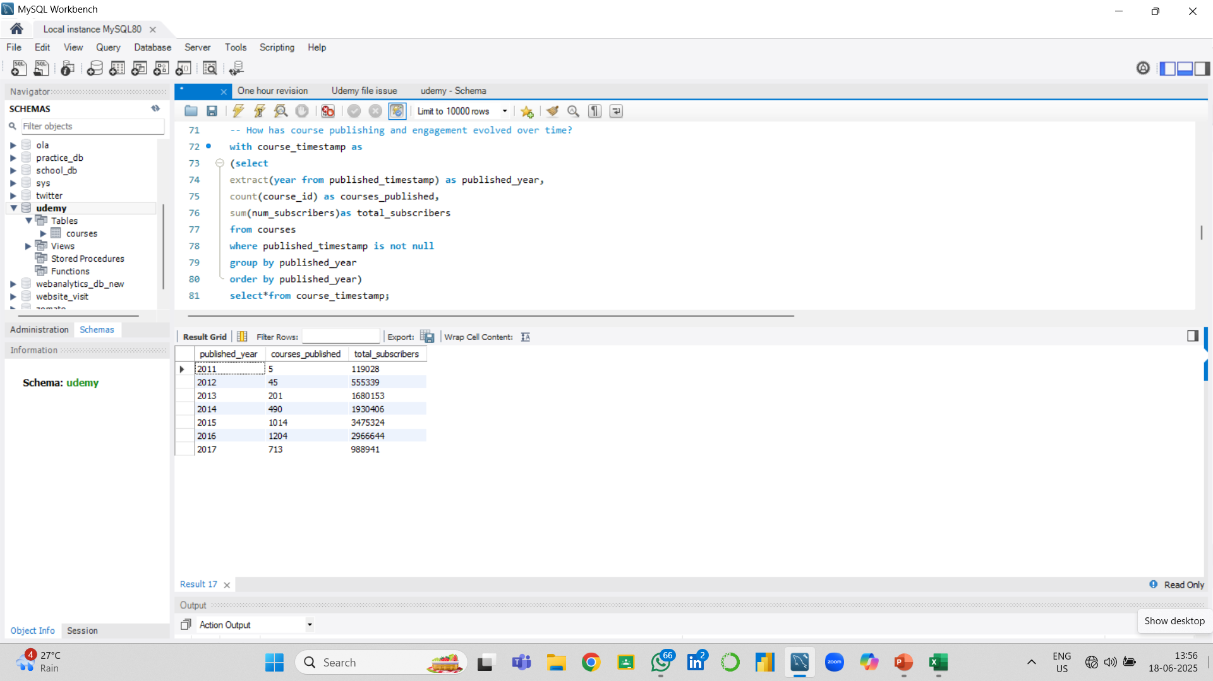
Yearly Growth Trends in Course Supply and Audience Engagement
Insight:
Between 2011 and 2015, Udemy experienced exponential growth in both the number of courses published and total subscribers. The course count peaked at 3.4million in 2015. This upward trend indicates strong platform momentum and user engagement during this period. However, from 2016 onward, while course publishing remained high in 2016, a sharp drop in subscribers was observed in 2017, suggesting signs of content saturation, reduced marketing efficiency, or user fatigue.

Slide 15

📈 Key Findings (Business & Learner Insights)
1.Web Development courses generated the highest revenue (₹6.27 Cr), much more than the other subjects.
2.Courses marked as "All Levels" brought in the most income, showing that flexible, open-level courses attract more learners.
3.Free courses, though fewer in number (~8%), led to a major potential revenue loss, especially when popular courses were not monetized.
4.The sweet spot for course duration is between 2–5 hours—these had the best engagement.
5.Paid courses had 5x more subscribers and reviews than free ones—proving that people value paid content more.
6.Some underpriced courses (₹20–₹50) had 30,000+ students, meaning they are highly popular but not priced accordingly—an opportunity for bundling or price adjustment.
7.Year-wise analysis showed that Udemy peaked in 2015, and saw a drop in course performance by 2017—possibly due to too much content or quality dilution.

Slide 16

Recommended Action:
Identify top underpriced, high-demand courses using review and enrollment data.
Test small, gradual price increases to see learner response without sudden drop-offs.
Design attractive bundle offers that group popular courses for better value.
Monitor changes in enrollment and feedback to adjust pricing strategy.
Share findings with instructors to align pricing with learner expectations and perceived value.

Slide 17



LinkedIn: https://www.linkedin.com/in/suchorita-das
Email: suchoritadas15@gmail.com
Thank You for Exploring This Project with Me 🤝
I appreciate your time and interest in reviewing this Udemy course analysis project. I'm always open to feedback, collaboration, or deeper conversations about data, product thinking, or learning platforms.
Notes:
14

